Slide 1
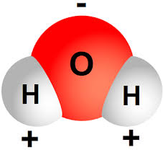
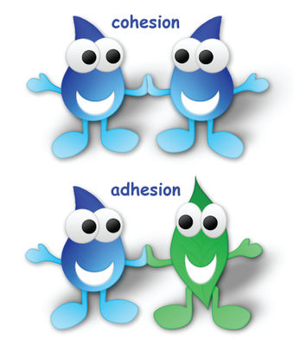
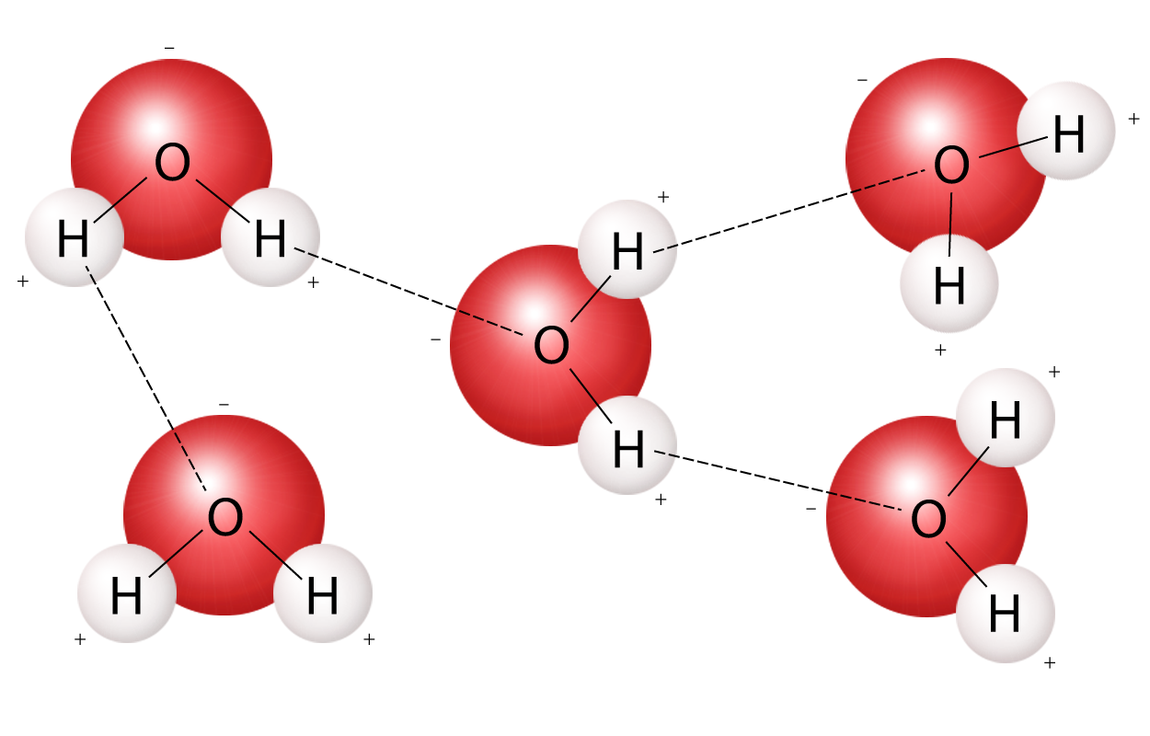
Water has unique and complex physical and chemical characteristics.
Nature of Water:
Two hydrogens and one oxygen molecule
The bipolar nature of water allows for cohesion and adhesion.
Notes:
It is these unique characteristics that make water so special and important.
More precisely, the positive and negative charges of the hydrogen and oxygen atoms that make up water molecules makes them attracted to each other. In a water molecule, the two hydrogen atoms align themselves along one side of the oxygen atom, with the result being that the oxygen side has a partial negative charge and the side with the hydrogen atoms has a partial positive charge. Thus when the positive side on one water molecule comes near the negative side of another water molecule, they attract each other and form a bond.
Cohesion is when water molecules stick to other water molecules. This is how water droplets form, and eventual rivers, lakes, streams, and even oceans.
Adhesions is when water molecules stick to other molecules and surfaces. Any easy example of this is water droplets sticking to the side of a glass when enjoying a beverage. Clouds form when water molecules stick to dust and other particles in the air.
Adhesion and cohesion are water properties that affect every water molecule on Earth and also the interaction of water molecules with molecules of other substances. Essentially, cohesion and adhesion are the "stickiness" that water molecules have for each other and for other substances.

Slide 2
WATER CYCLE: Lesson 1.2
Molecules in Motion
Investigative Question
What are the relationships between heat and the movement of water in the water cycle?
Notes:
So we want students to start to think about how water behaves… we are going to think about energy and matter a lot here, that’s one of those cross-cutting concepts that we need to know about.

Slide 3
WATERCYCLE: Molecules in Motion
Demonstration
Students will observe the motion of water molecules using food coloring so that those motions are visible and will brainstorm driving questions to explore what is happening.
Notes:
We will be watching this video, but I recommend doing this live in the classroom if possible…
I also suggest that you can do the first part of the demonstration as a whole class activity, and then the second part you can do in small collaborative groups.
Please make observation and think about what is happening and why? Stop at 1:56 so that teachers can answer questions.

Slide 4
WATERCYCLE: Molecules in Motion
Create a See-Think-Wonder Chart
What did you see/observe in the left jar and the right jar when food coloring was added?
What ideas do you have about why the dye may have behaved the way it did in each jar?
Notes:
When you do this activity with your class make sure to have them create a See-Think-Wonder Chart in their science notebook and fill this in as you do the demonstration and experiment.
Please unmute and share your thoughts or type it into chat: The jars has the same liquid in them, fresh water, one was just hot water and one was cold water.
Heat is a form of energy, so heat energizes the water molecules. Water molecules will move faster when they are hotter and have more heat energy. Water molecules will move slower when they are colder and have less heat energy.

Slide 5
WATERCYCLE: Molecules in Motion
Notes:
Have students make predictions before you start this part of the activity…
Tips: This is where I would let groups of students do this part of the experiment. Also, we have found that it is helpful to add more food coloring into the jar to make it more intense before ladling it out into room temperature cups. Make a tiny ladle and have students dip ladle into the hot/cold water and then place it into the room temperature cup of water.
In table groups, students will slowly and carefully insert a vial of hot water and vial of cold water (colored so that we can see it) into two separate cup of room temperature water.

Slide 6
WATERCYCLE: Molecules in Motion
Investigation
Why do you think the hot water rose while the cold water stayed in the vial?
What does this experiment tell you about how hot water behaves versus cold water?
Notes:
Either unmute or put answers in CHAT!
Your students might understand that molecules that are warmer move faster, but they may not…
So warmer molecules are moving faster, also heat rises. Hot things go up why? Hot water rises because water molecules are moving faster and are more spread apart than room temp water. Cold water stays below in the vial because the water molecules are moving slower and stay closer together, causing the colder water to stay at the bottom.
Density decreases with a rise in temperature, so what’s actually happening is the molecules are less close together, the molecules are not as tightly packed.
So there are some other models you can use with your students.

Slide 7
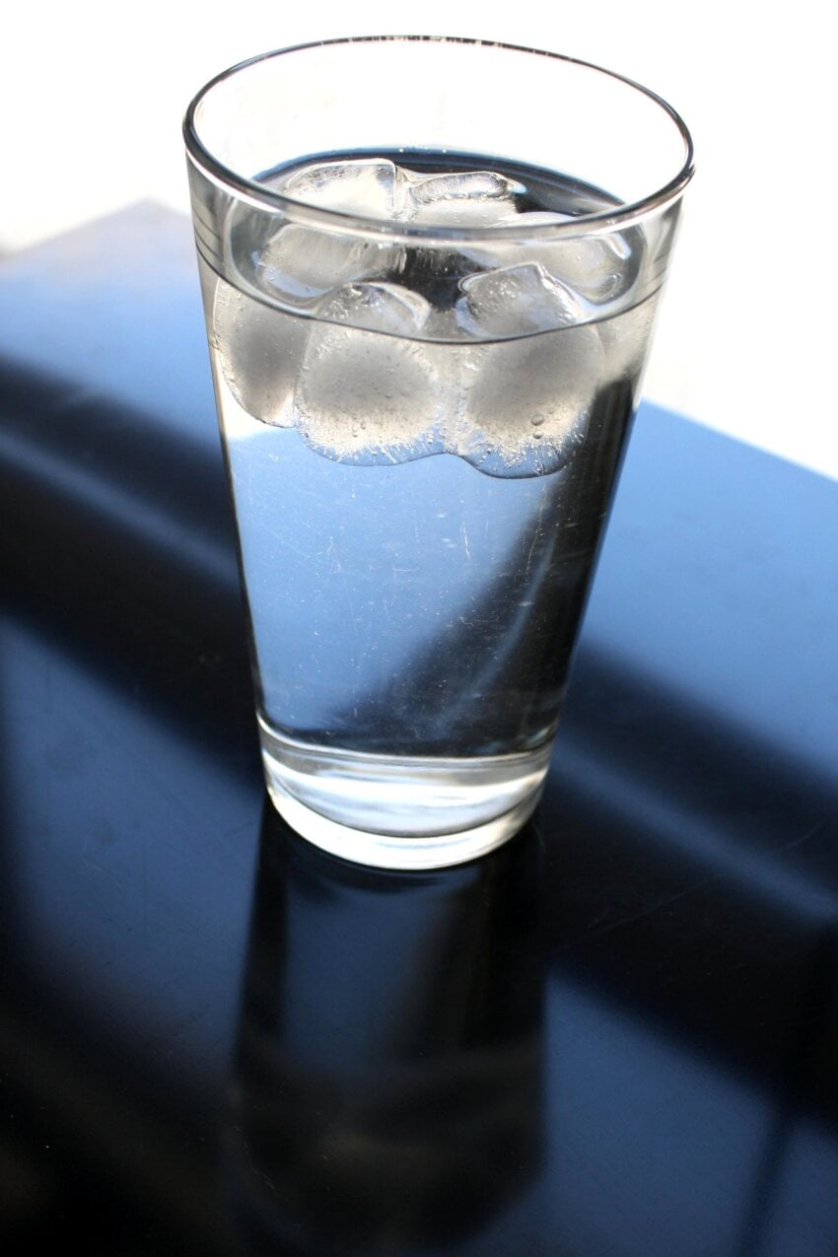
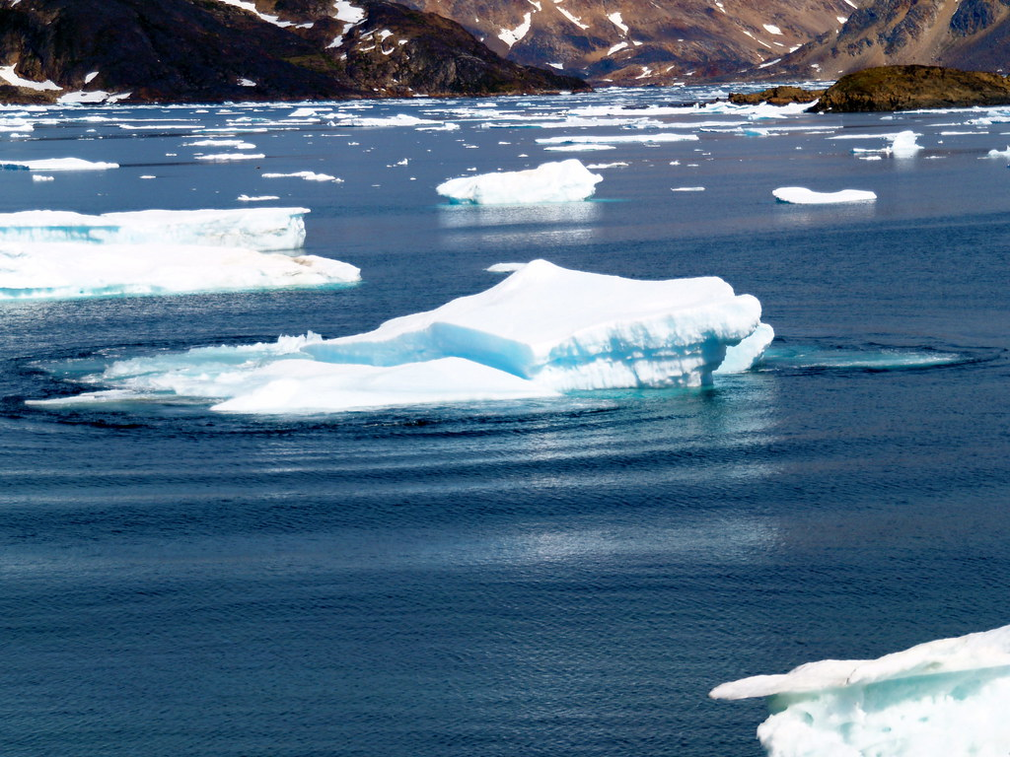
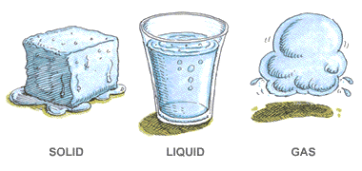
WATERCYCLE: Molecules in Motion
Whole Body Simulation
Students get to become water molecules and participate in a full-body activity to see how heat affects movement of molecules.
Notes:
You can also do this activity in the classroom and have the students change states according to the speed of music – with the music representing heat energy.
In this activity students become water molecules and start as water in a gas form (students move freely and quickly, waving hands and wiggling fingers). Over time some heat energy is lost and they now become liquid. As a liquid they begin bonding with other molecules and letting go (do this by putting a hand on a neighbor’s shoulder and letting go and then moving on to another). More heat is lost and they become slower and slower as the temperature drops and now they get very close together (like we observed the cold water in the vial did). But when water gets cold enough it does an amazing thing… what happens? It freezes and becomes a solid and expands into ice. As ice water molecules stay bonded making crystal hexagonal structure (have students in groups of 6 put a hand on shoulders and stiffen their arms).
Now that you are ice are you closer together or farther apart, then when you were a cold liquid? Farther apart… so what would happen if we put ice in room temperature water? What does the ice do? It floats! Water molecules turn solid in ice form and spread out creating more space making them float… this is very important to the water cycle that ice floats. If the water at the bottom of lake froze first then all the fish would die…

Slide 8
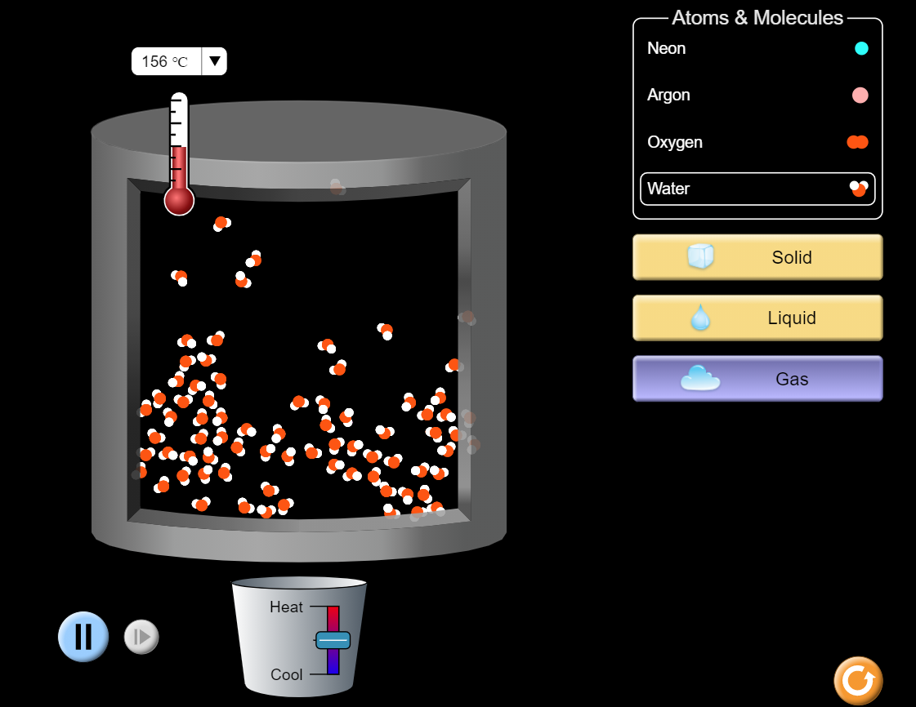
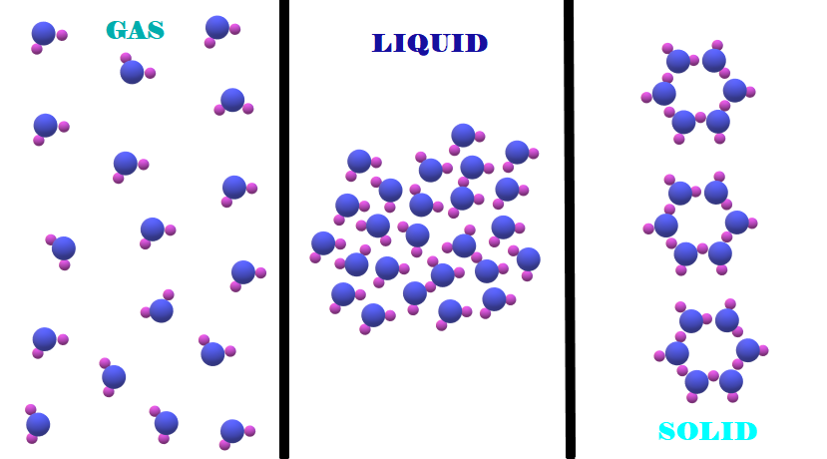
WATERCYCLE: Molecules in Motion
Water Molecule Simulation
https://phet.colorado.edu/sims/html/states-of-matter-basics/latest/states-of-matter-basics_en.html
Notes:
See the hexagon shape of water when it turns to ice and is a solid state.
You can also use this online simulation to so your students can see molecules in motion in another way. So you can play the game outdoors or indoors, and then you can use this model. Select States of Matter, select water, and then you can heat it up and cool it down to see the molecules move accordingly.

Slide 9
Wrap-Up
Lesson 1.2
When we add or subtract heat to water, it changes, and that is important!
What heat source drives the water cycle again?
Cause and Effect
&
Energy and Matter
Notes:
Make sure you have your students add the sun on water cycle diagram and label as the heat source!

