Slide 1
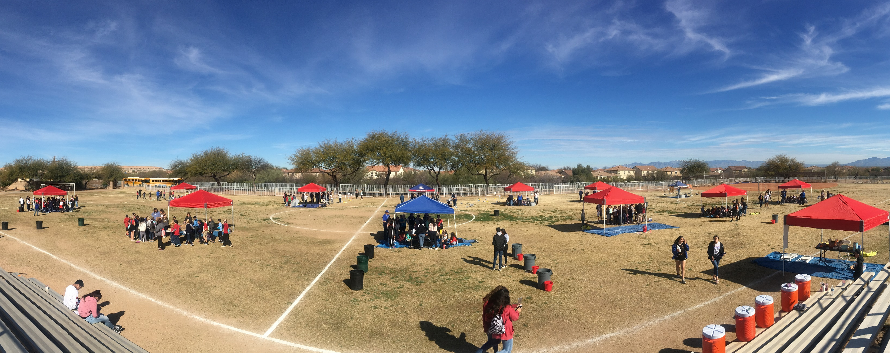
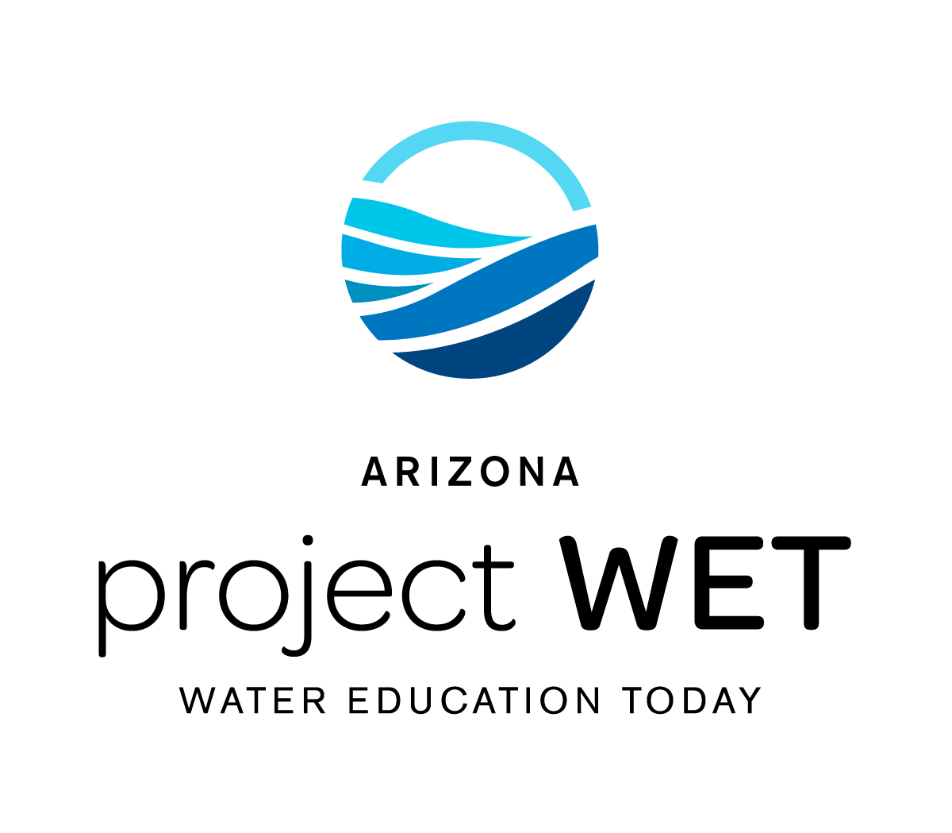
Arizona Project WET
Water Festival Unit
2024-2025

Slide 2
WATER FESTIVAL
UNIT
GUIDING QUESTIONS:
Where is Arizona’s water?
What are the connections between people, water, and heat in the environment?

Slide 3
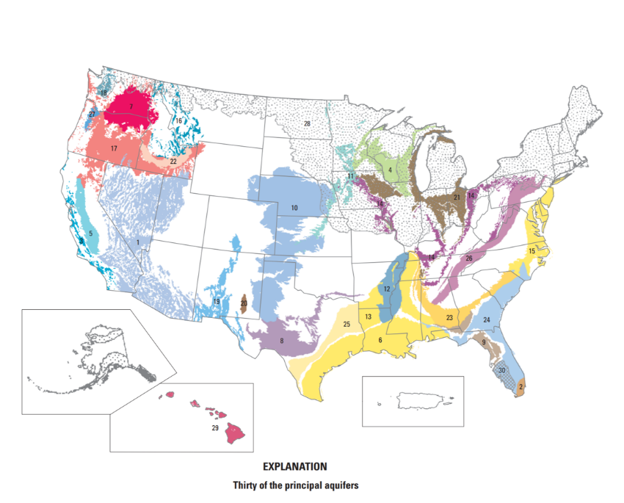
GROUNDWATER & ARIZONA: Lesson 5
Unearthing Groundwater:
Groundwater Use in the U.S.
The National Ground Water Association has determined that 38% of the U.S. population, depends on groundwater for its drinking water supply.
Notes:
Groundwater is the largest source of fresh water on Earth - it's kind of a big deal! In fact, there is over a thousand times more water in the ground than is in all the world's rivers and lakes.
https://www.usgs.gov/special-topics/water-science-school/science/groundwater-information-topic

Slide 4
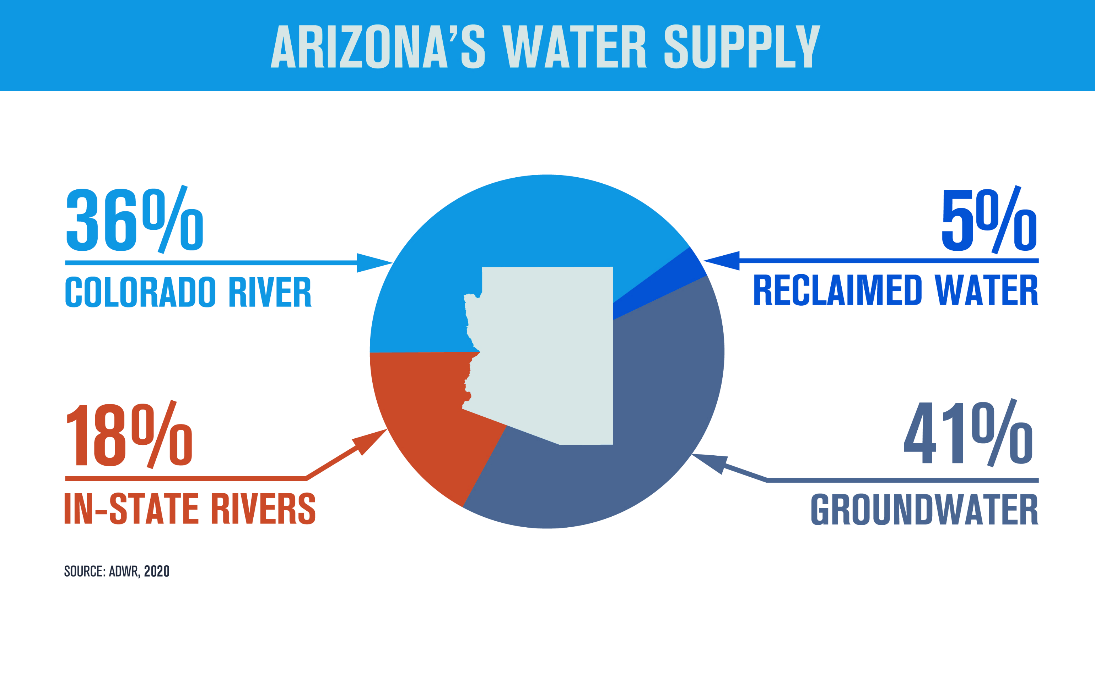
GROUNDWATER & ARIZONA: Lesson 5
How important is groundwater to Arizona?
Notes:
Arizona uses water from several sources. Some of it comes from rivers, and a small amount which we are trying increase is coming from reclaimed water, but currently most of our water comes from groundwater!

Slide 5
GROUNDWATER & ARIZONA: Lesson 5
Groundwater Connection
Investigative Questions
How does groundwater fit within the Arizona Water Cycle?
What is the relationship between groundwater and surface water?
Notes:
So now that we better understand what a watershed is, we can see how humans impact watersheds

Slide 6
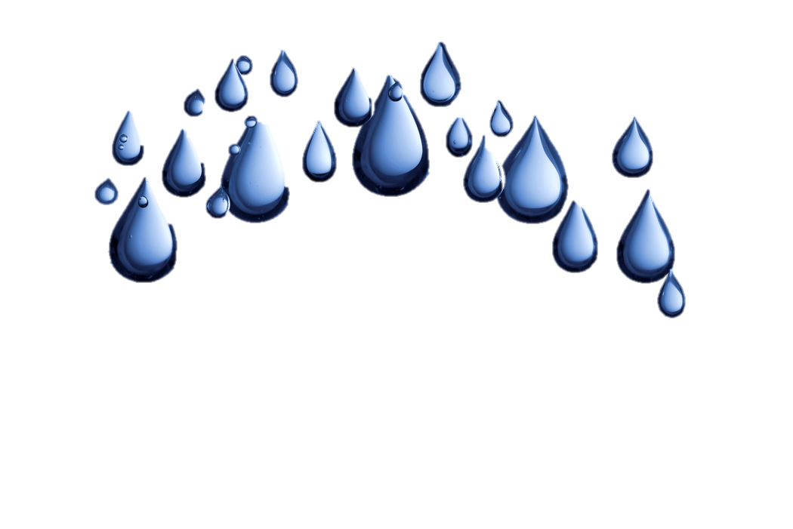
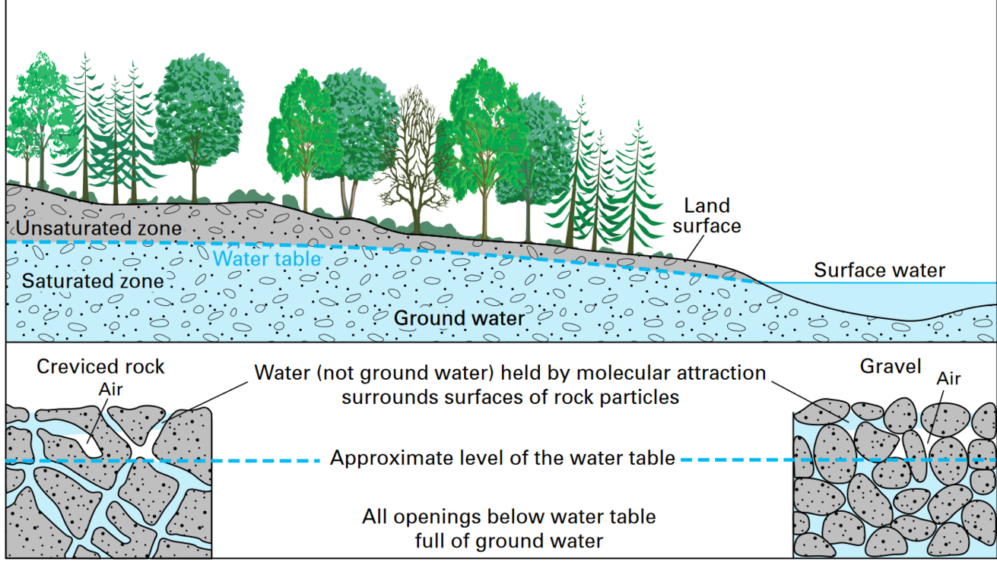
Let’s
Review!
Pore Spaces
Groundwater moves between the spaces and pores and is pulled down due to gravity. The bigger the spaces between the materials, the faster or easier the water can move around it.
Aquifer:
An area where significant groundwater is present. Groundwater is flows between layers of earth materials.
Notes:
Groundwater begins as what? Where does it come from? Precipitation Then what happens? It runs off the land until it can find places to soak down through materials or it fills up surface water.
Groundwater is what it sounds like - water in the ground that fully saturates (or fills up) the pores or cracks in soils, sand and rocks. Then what is an aquifer?
An aquifer is an underground bed of saturated soil or rock that yields significant quantities of water. Aquifers come in all sizes and their origin and composition are varied. They may be small or very large and can run for thousands of square miles underground all while remaining out of sight.

Slide 7
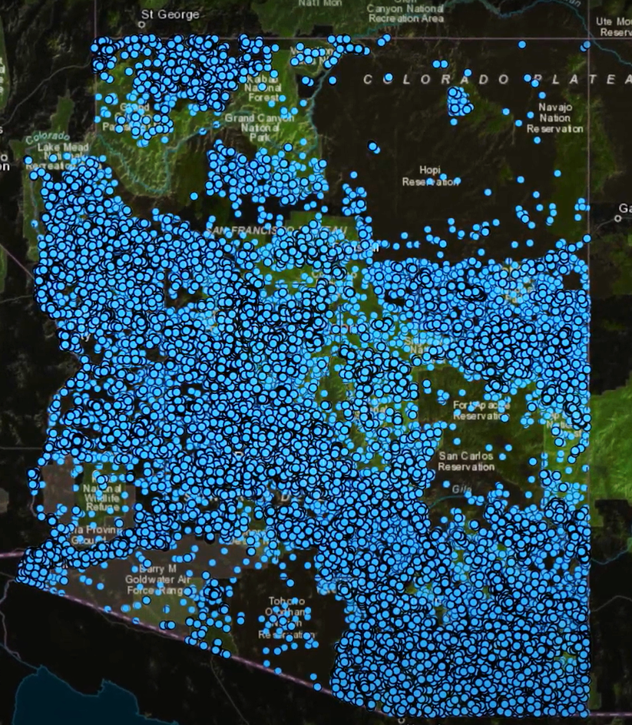
GROUNDWATER & ARIZONA: Lesson 5
Well, well, well, what do we have here?
How do we get to and use groundwater?
Both individual landowners and city municipalities drill wells to access groundwater.
Notes:
So how do we get groundwater ? Remember we pump it up through wells! The only we can use it is by pumping it up.
Can you believe there are so many wells all over Arizona?

Slide 8
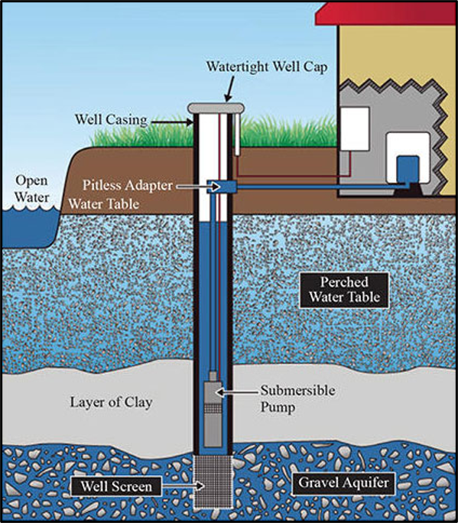
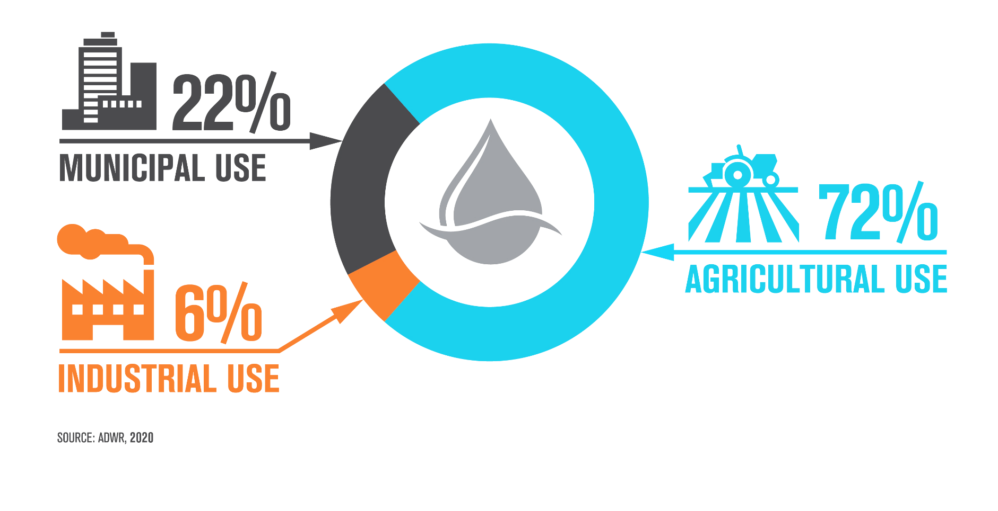
GROUNDWATER & ARIZONA: Lesson 5
How do we pump it up
and why?
We use it for drinking water, agriculture, and for pretty much everything else.
Do different places have different amounts of groundwater? Do you think it is evenly distributed under Arizona?
Notes:
Just like surface water (lakes and rivers), our groundwater is not evenly distributed across the state…
There are many types of wells (some are observation wells so that we can see what is under our feet and some are pumping wells). Some are only 100s of feet deep while others can be 1,000s feet deep. But they all are expensive
A drilled well is constructed by a rotary drilling machine that literally “drills” a hole into the ground until it reaches the underground water source. These types of wells require a casing on the outside of the drilled hole as well as screening to prevent the driving water from being contaminated. The screen also reduces the amount of sediment flowing into the water storage tanks and can also improve the integrity of the well. These types of wells can reach depths up to 1,000 feet. Once the drilled well has been opened, a submersible water pump and piping system are installed and a casing cap is installed on top of the water wells, which also is designed to protect the integrity of the below-ground water source and reduce exposure to chemicals and other contaminants.

Slide 9
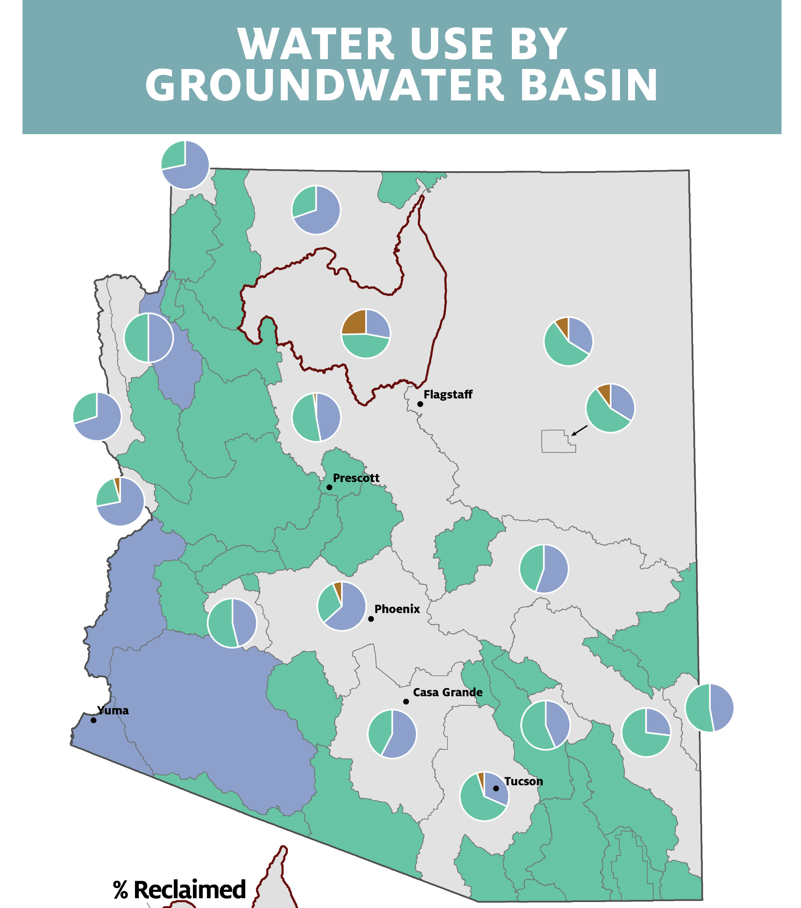


GROUNDWATER & ARIZONA: Lesson 5
Deeper Dive: We all need and use water!
What if we just keep pumping and taking all the groundwater we want? Can this lead to problems?
Notes:
Remember Arizona is diverse with different water sources, but this shows the different groundwater basins and the main source of water in each area.
Does anyone know what reclaimed water is ?
At the festival students will be able to see first hand that groundwater is connected to surface water and so you can ask what happens to the surface water (our rivers and lakes) if we take too much ground water ? They can dry up!

Slide 10
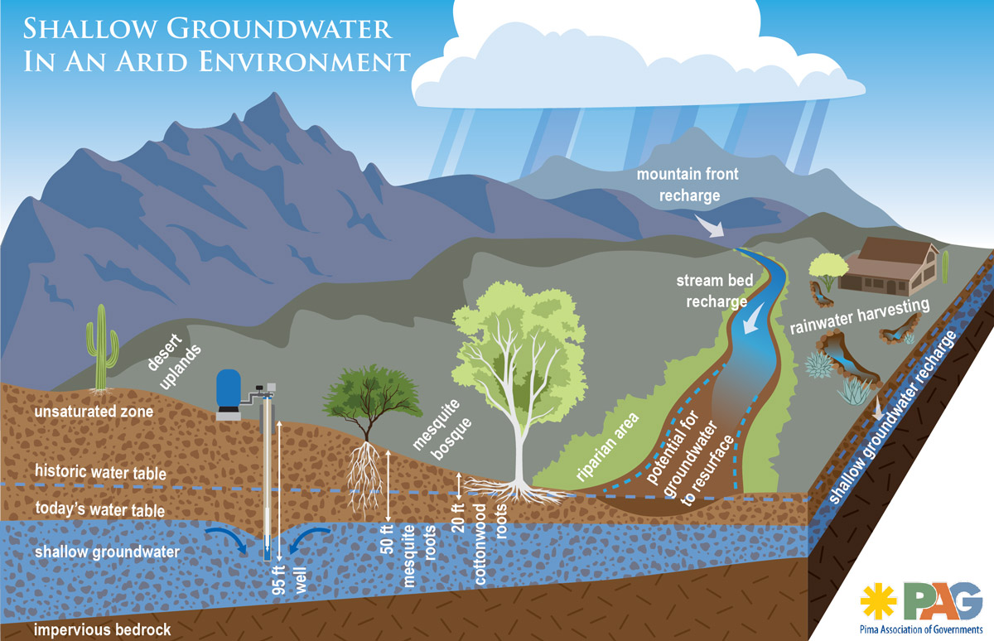
Going, Going, Gone?
Decline & Depletion
Notes:
The water stored in the ground can be compared to money kept in a bank account. If you withdraw money at a faster rate than you deposit new money you will eventually start having account-supply problems. Pumping water out of the ground faster than it is replenished over the long-term causes similar problems. We call this overdraft
Pumping groundwater at a faster rate than it can be recharged can have some negative effects on the environment and the people who use that water:
LOWERING OF THE WATER TABLE – a severe consequence of excessive groundwater pumping is that the water table, below which the ground is saturated with water, can be lowered.
If groundwater levels decline too far, then shallow wells may dry up causing well owners to drill deeper (this is very expensive and not always possible.
We also know from what we saw at the festival, if we take too much groundwater it can reduce the amount of water in our streams, rivers and lakes.
We also call the area that lowers around the well that is pumping water, a cone of depression…

Slide 11
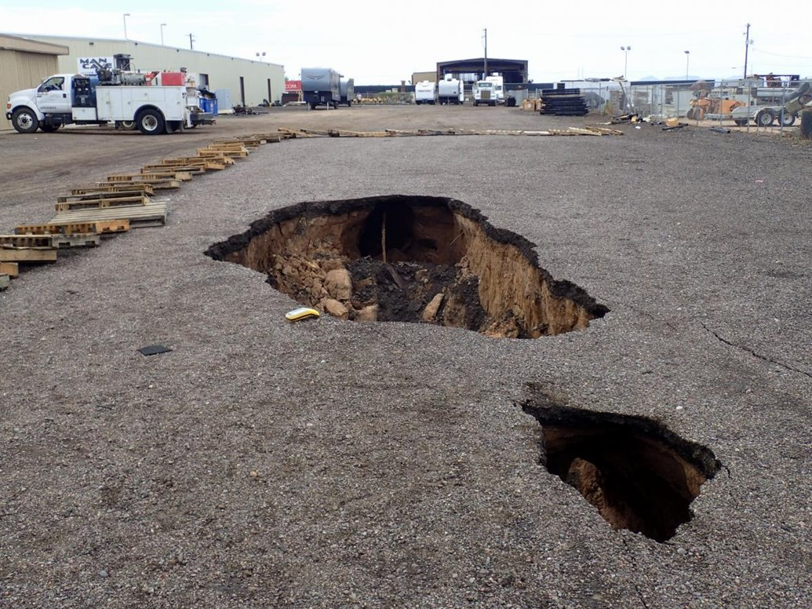
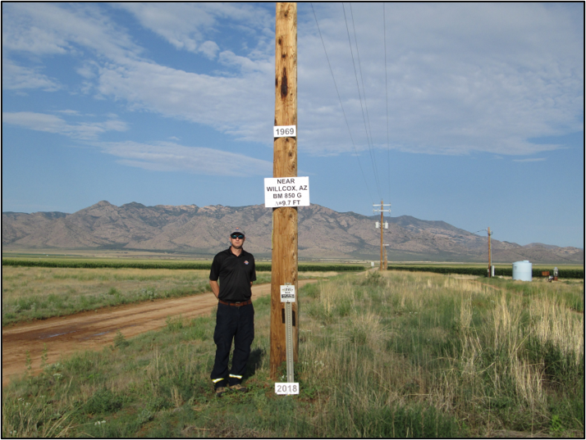
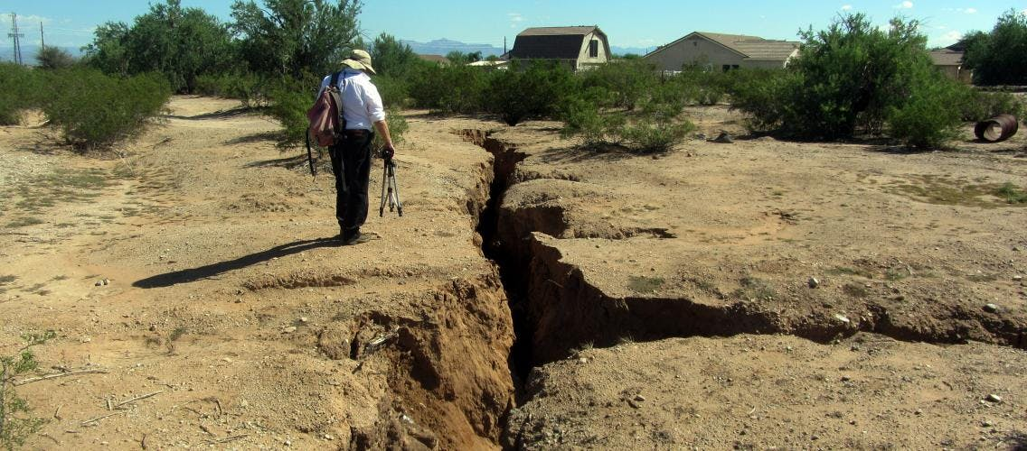
Sink Holes, Fissures & Land Subsidence, Oh My!
Notes:
So when we take too much groundwater besides drying up lakes and rivers, we can also cause damage to the land!
This is a 2-mile-long crack that opened in the AZ desert in Pinal County between Casa Grande and Tucson because of groundwater pumping! The land subsided more in one area than in another, so it caused the earth to crack open. We call this a land fissure, and we have no idea if they can be repaired or how to repair them. ​
​
The bottom right picture is near Wilcox, AZ where the land has actually started to subside due to over pumping of groundwater. When land subsides, it loses its capacity to hold groundwater, as the spaces between the materials collapse and get smaller and smaller, so we can’t just pump water back into the ground to fix subsidence issues.​
​

Slide 12
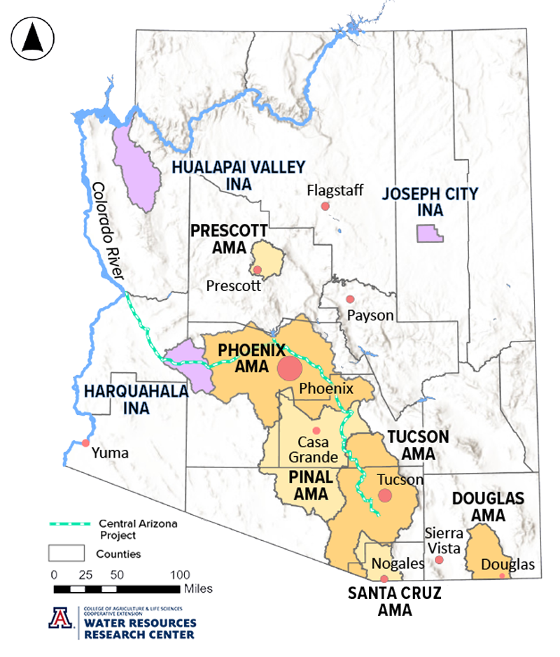
GROUNDWATER & ARIZONA: Lesson 5
1980 Arizona Groundwater
Management Act
Active Management Area and Irrigation Non-Expansion Area designations​
Groundwater pumping limitations​
Recharge​
Notes:
Because of over pumping and the issues we just discussed finally in 1980 The 1980 Arizona Groundwater Management Act (GMA) was passed.
The passing of the 1980 Groundwater Management Act (GMA) was monumental for many reasons. First and foremost, it established laws that enabled the State to manage and protect groundwater for the benefit of all residents across Arizona. It also created provisions to ensure this finite water source was preserved for the future.
It created Active Management Areas (AMAs), which introduced regulation and conservation measures in parts of the state with a history of heavy reliance on groundwater.
There are six AMAs in the state, Prescott, Phoenix, Pinal, Tucson, Santa Cruz and Douglas. Each has its own long-term goal in accordance with the Groundwater code
INAs – are Irrigation Non-expansion areas which prohibit the expansion of new irrigated acreage within established boundaries and require irrigators to report their water use if they pump more than 35 gallons per minute. There are 3 INAs.

Slide 13
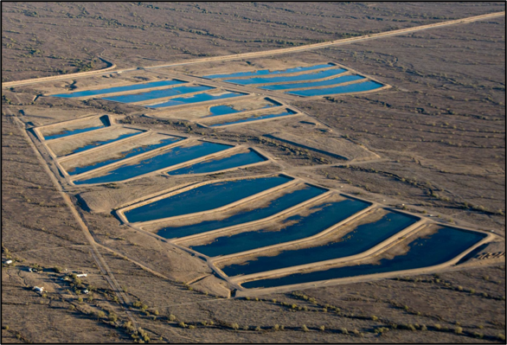
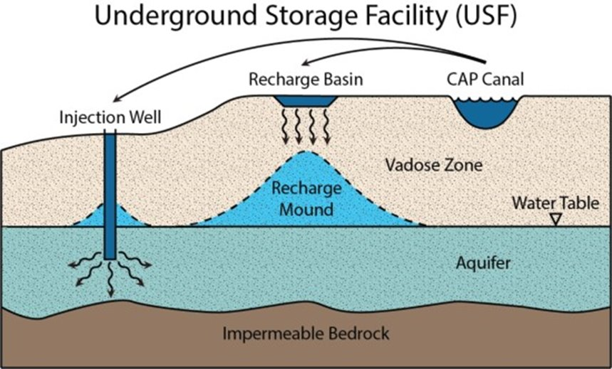
GROUNDWATER & ARIZONA: Lesson 5
Recharging the Aquifer
Notes:
. Phoenix and Tucson are both trying to achieve safe-yield –which means the amount being drawn or taken is the same amount being replaced annually.
Where do you think we might get water to recharge into the ground? We often get this water from the Colorado River. We build basins in the ground and put water from the CAP and reclaimed water (treated wastewater) into them to recharge the aquifer. ​
What are the benefits of storing water underground rather than above ground? It stops evaporation. ​​

Slide 14
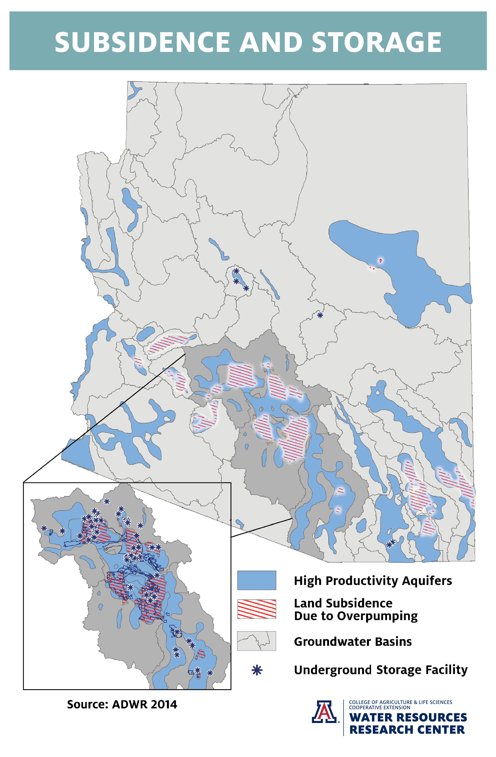
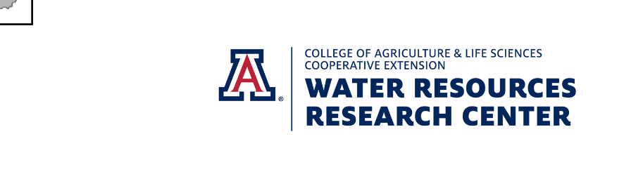
Notes:
Back in the 1950s, approximately 70 percent of the water used in Arizona was groundwater.
Even though the overall usage of groundwater in Arizona has been reduced to 40 percent, groundwater is still a fundamental water source and in some areas of Arizona, it remains the only water source, highlighting the importance of managing this resource not just for today but for future generations.

Slide 15
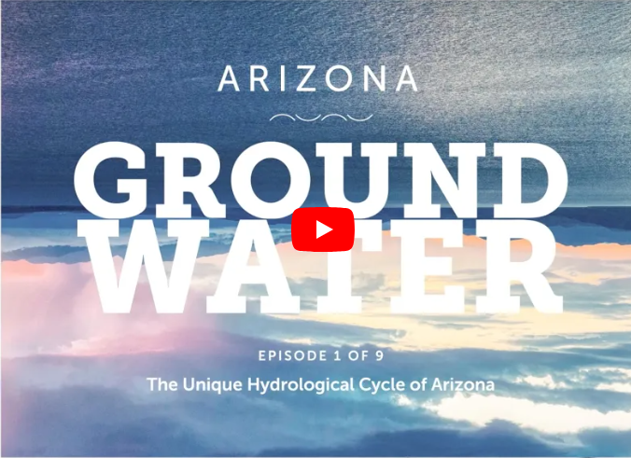
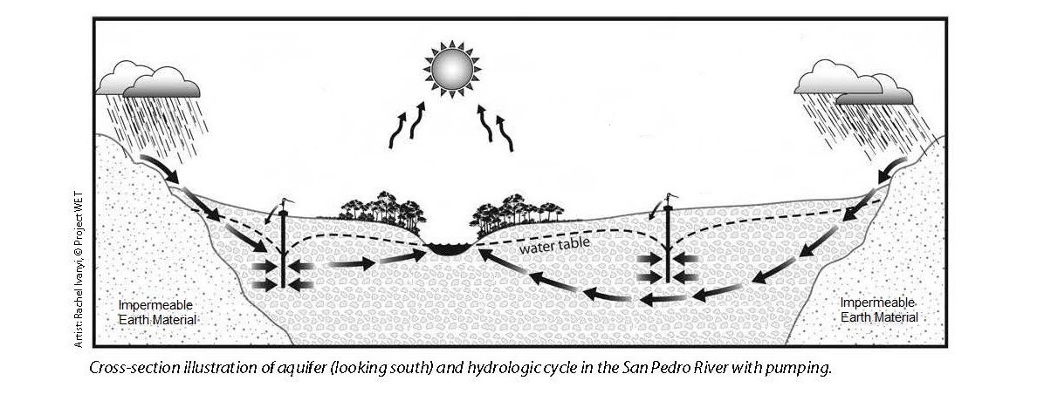
GROUNDWATER & ARIZONA: Lesson 5
The Activity:
Watch Episode 1 & 2 of Arizona Groundwater Videos – an APW & ADWR joint project.
Have your students work together in groups to label and discuss the groundwater worksheet.

Slide 16
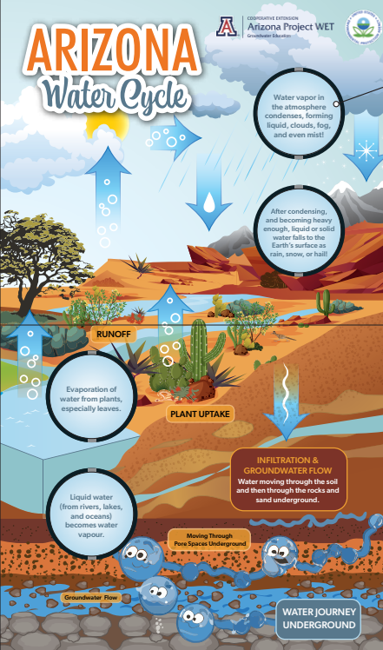
Wrap-Up
Stability &
Change
Lesson 5
What have you learned about the relationships between groundwater and surface water?
How does groundwater fit within the Arizona Water Cycle?
Do we have a groundwater relationship that is built to last?
Notes:
They are connected, and yes it is definitely part of the water cycle…
100% you can be a groundwater guardian, have students share in groups things they can do to protect and conserve groundwater. In the next lesson you will discover how you can make individual actions that help us conserve water and help keep it clean and plentiful.

