Slide 1
Arizona Project WET
Water Festival Unit
2024-2025

Slide 2
Student Pre and Post Survey
V
https://awf.projectwet.arizona.edu/student-survey
BEFORE
AFTER
Please administer the survey before students start any of the lessons. This is not a test. Please feel free to facilitate reading the questions as a class.
Please administer the same survey again after completing the unit, ideally no more than four weeks after the water festival event.

Slide 3
WATER FESTIVAL
UNIT
GUIDING QUESTIONS:
Where is Arizona’s water?
What are the connections between people, water, and heat in the environment?

Slide 4
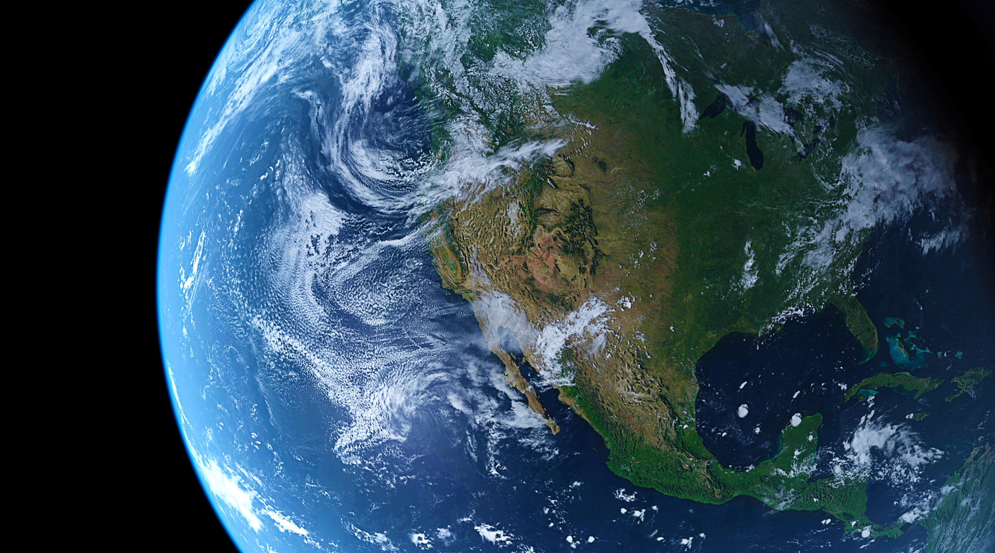
WATER FESTIVAL UNIT:
Water Principles
Water is essential for all life on Earth to exist.
Water connects all Earth systems.
Water is a natural resource.
Water has unique and complex physical and chemical characteristics.
Water resources are managed.

Slide 5
Introductory Lesson: How Does Water Behave?
Investigative Questions
How does water move and change form in the earth’s natural system ?
What are the forces that drive the water cycle?

Slide 6
Intro Demonstration Video:
Notes:
Students watch a demonstration (either live or the Arizona Water Festival Anchor Phenomena video) to determine how water behaves. First, students describe all the parts that will be used in the demonstration, helping them to understand that the heat is coming from the electric burner and that the ice is cold. When the cold pan is placed over the boiling pot (as shown in the diagram), they will describe every step of what they observe in the simplest language that they can (not using process words like evaporation).
This demo can be done throughout the unit until students understand two big ideas:
1. Water can be found in the earth system in three different forms:
• Solid – it holds its shape, whether inside or outside a container
• Liquid – it takes the shape of the container that it’s in. This is the most recognized form.
• Gas – it is not visible to the eye, so we can only prove that it’s there by investigation.
Heat is a form of energy that causes water to move and change form. The force of gravity helps drive the water cycle.
Water is the only naturally occurring substance on Earth that can be found in three physical states: solid, liquid, and gas.
This is also an important way to realize that water vapor cannot be seen, so only with experiments can we know that it exists.

Slide 7
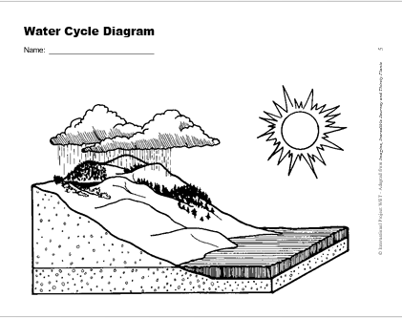
Wrap-Up
Energy and Matter
&
Cause and Effect
Notes:
Challenge students to think about heat as the energy and water as the matter and the relationships they observed.
Give them the diagram and have them label all of the water cycle parts and processes. (draw arrows, different colors, etc.)
These are the Cross Cutting Concepts demonstrated in this lesson

Slide 8
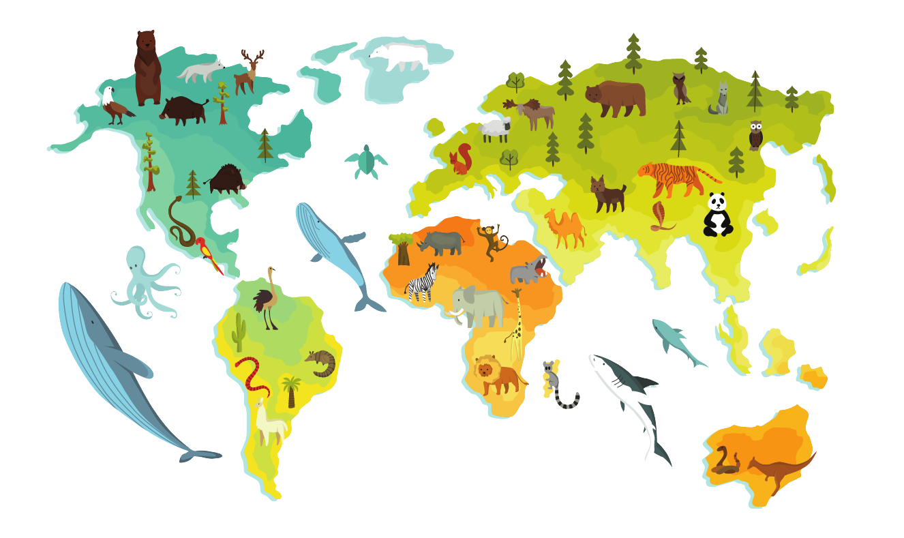
Water is essential for all life on Earth to exist.
Life processes depend on water, from the cellular level to the ecosystem level.
Is the freshwater supply that is available on Earth limited?
Both the quantity and quality of water contribute to sustainability of life on Earth.
Water sustains multiple users but is water distributed equally across the Earth?

Slide 9
WATER CYCLE: Lesson 1.1
A Drop in the Bucket
Investigative Questions
How much water on Earth is available for our use?
What is potable water?
Does everyone have access to potable water?

Slide 10
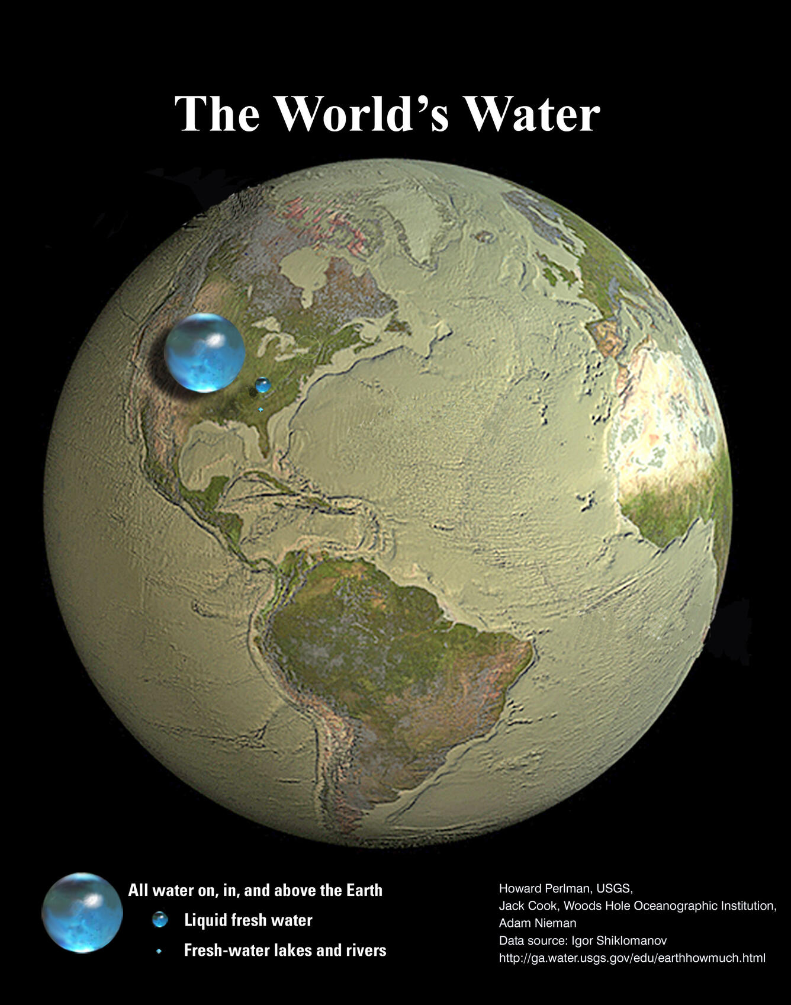
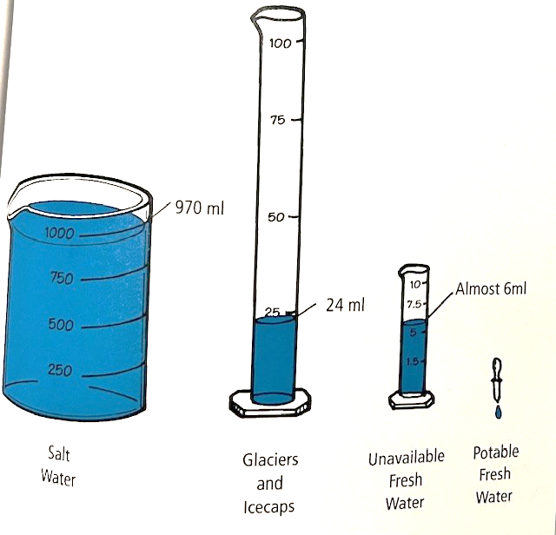
WATERCYCLE: A Drop in the Bucket
The Activity:
Potable water – freshwater that is safe to drink.
Ocean – 97% percent of water on planet
Freshwater – 3%
80% of that is frozen – polar ice caps
If not frozen, where is it found?
Surface water – 25%
Under ground – 75%
1 drop!
Notes:
You can do this activity as a class demonstration or in groups and let the students actually measure out the water. The picture will also take you to a great graphic and more information.
Helping students make that connection as to just how precious a resource our fresh clean water is, helps make water conservation relevant.

Slide 11
How much water do we have in Arizona? Why?
Total land area of Arizona:
113,990 square miles
Total water area of Arizona:
0.3%
Aquifers =
Notes:
https://www.usgs.gov/special-topics/water-science-school/science/how-wet-your-state-water-area-each-state
We don’t have much water compared the size of our state… so what does this mean?
Water is not distributed equally across the Earth-there are arid regions and wet regions.

Slide 12
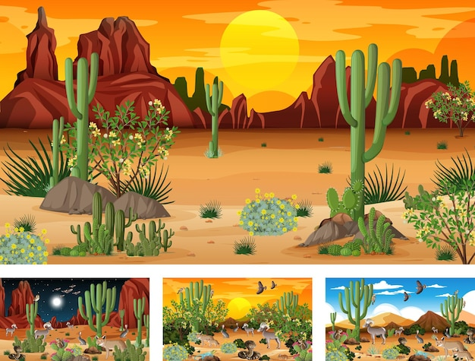
Investigative Questions
How does water move through our local water cycle?
Are you a part of our water cycle ?
Does water move in and out of your body?
We live in a desert!
Notes:
Have your students brainstorm and think about what their local water cycle looks like. What processes are happening? Is it dry or wet most of the time? Are there trees and plants? Animals? People? Who can put in the chat a way you are part of the water cycle or that water moves in and out of your body? People drink, perspire (sweat), breathe –respiration, and urinate – so yes water does move through our body, and we are part of the water cycle
So why is Arizona a Desert? What makes a desert a desert? Region of land that has an arid/dry climate receiving less than 25 centimeters (10 inches) of sporadic rainfall annually

Slide 13
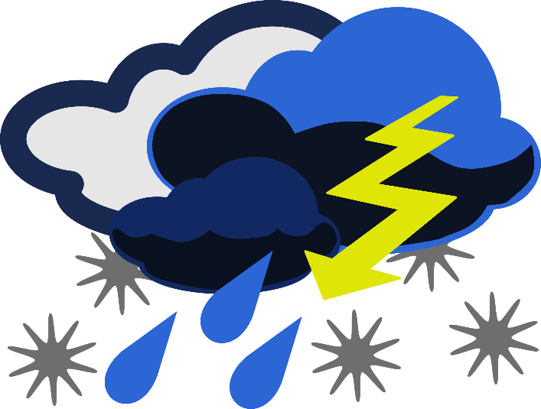
What is climate?
Is climate the same as weather?
Weather: what happens day to day (temp, clouds, precipitation)
Climate: is average measurements over several years
Climate is what you expect, and weather is what you get
Notes:
Because when we live in a desert the climate and weather is a specific way. And this has an effect on the water that we have.
Who can unmute or put in chat what is Weather?
Our climate and weather play an important role in regards to what does happen to the moisture we have here in Arizona…

Slide 14
What is
evapotranspiration?
What is evaporation?
What is transpiration?
What form is water changing from and into during each process?
This Photo by Unknown Author is licensed under CC BY
Notes:
Read slide first – water goes from a liquid into a gas – water vapor. then say what do we get when we combine these two processes?
Evapotranspiration – combining evaporation and transpiration together, which means it is all the water that’s coming off the soil. Overall Evapotranspiration is an important process in the water cycle because it is responsible for a substantial amount of the atmosphere's water vapor. Without that input of water vapor, clouds couldn't form and precipitation wouldn’t fall.
So we are going to look at some climate tables.
More info if needed: They measure evapotranspiration in different ways, but one scientific instrument mainly used by farmers is called an atmometer and is usually used with alfalfa crops or grasses, to get the data for different areas. Another measuring device is called a lysimeter.

Slide 15
Notes:
Notice inches of rainfall, what is our max?
Note this is over the year

Slide 16
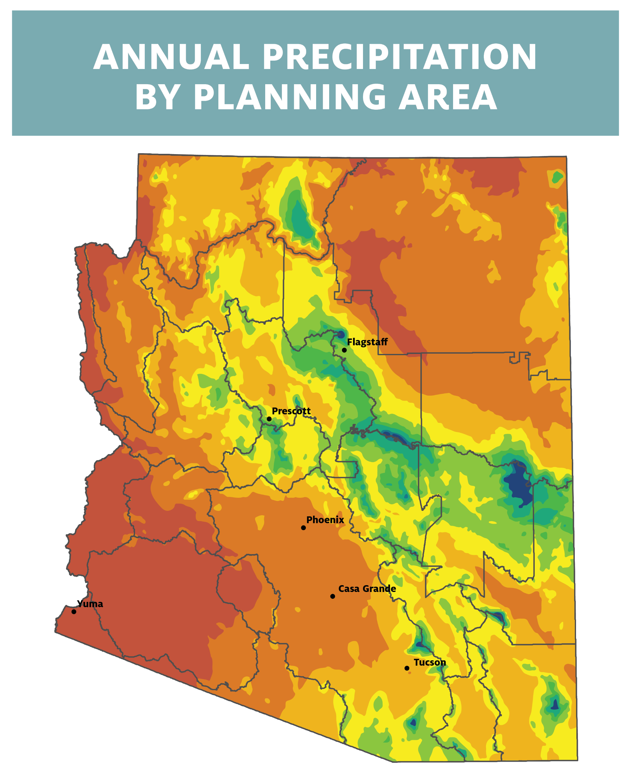
Notes:
Here we cans see that while we do get some rain, most places do not get a lot! Where do we get the most ? The mountains!

Slide 17
Notes:
This is now looking at the same data but monthly. What do we notice about this graph… there is some consistency among all locations dependent on time of year (winter months, monsoon months), but some places definitely get more rain than others

Slide 18
Notes:
Notice max especially when compared to our rainfall max (only 12 inches in Tucson)

Slide 19
Notes:
We don’t have as much data for all the specific places, but we can still see the overall trend of when evapotransporation happens the most… summer/hotter months

Slide 20
Notes:
We get a lot more evapotranspiration then we get precipitation… so what does this say about our climate? If you were an alien and looked at this data, what would you expect the climate to be like in Arizona? What kind of plants would you expect to find? this is going to be a very dry place – a desert, it isn’t that we don’t get rain or precipitation, but that our Evapotranspiration is much higher than our precipitation. About 7 x more …

Slide 21
Notes:
What does this mean for your local water cycle and climate? It means we need to be smart about the water we have

Slide 22
Wrap-Up
Lesson 1.1
How are the climate of Arizona and the water cycle connected?
Do you think climate change may have even more affects on water resources in the future?
Cause and Effect
&
Stability and Change
Notes:
Climate and water are inseparable. Changes in climate may lead to less snow in the mountains and warmer streams. This will impact the amount and quality of water in the rivers.

